Slide 1
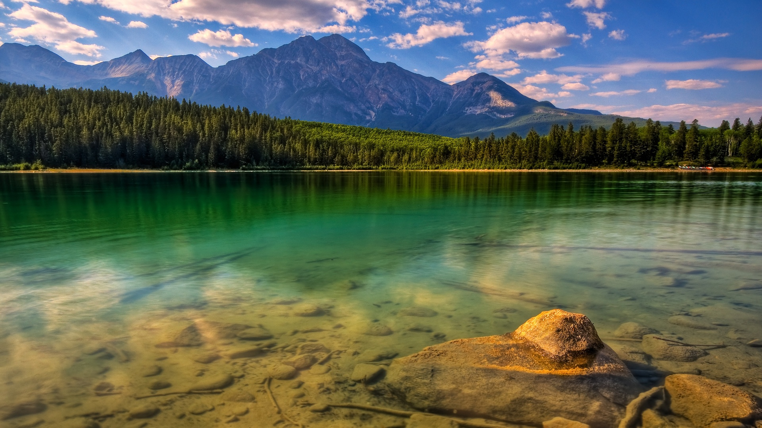
WATER……

Slide 2
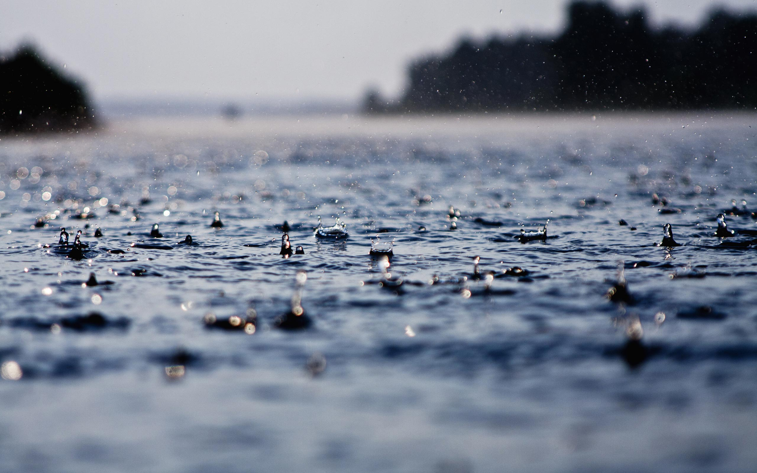

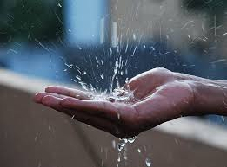
RAINWATER
HARVESTING
PRESENTED BY
ADITYA

Slide 3
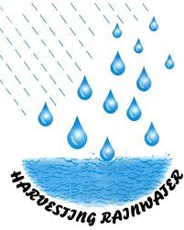

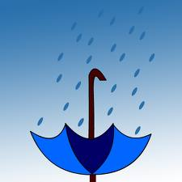

WHAT IS RAINWATER HARVESTING???
RAINWATER HARVESTING IS THE ACCUMULATING AND STORING OF WATER FOR REUSE BEFORE IT REACHES THE AQUIFER.
THE PRINCIPLE OF COLLECTING AND USING PRECIPITATION FROM A CATCHMENT SURFACE.

Slide 4
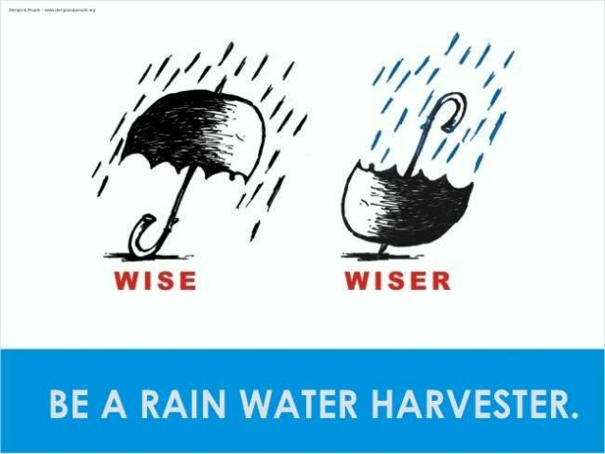

Slide 5

WHY RAINWATER HARVESTING??

Slide 6
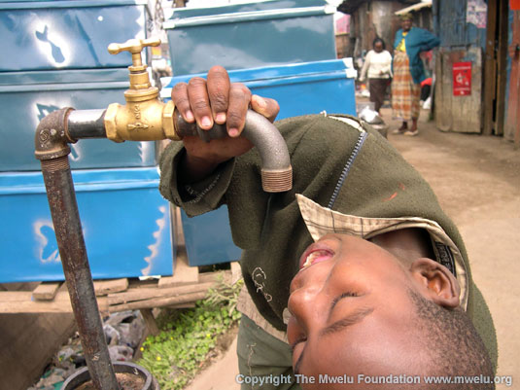
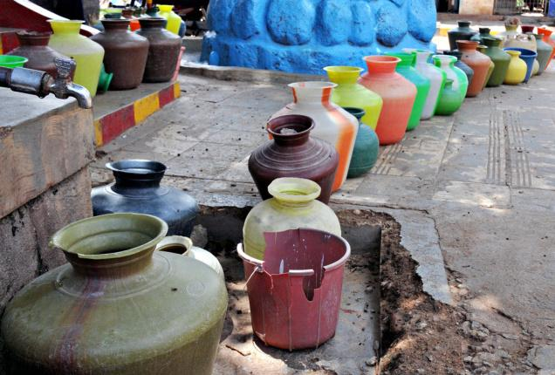
SURFACE WATER IS INADEQUATE TO MEET OUR DEMANDS AND WE HAVE TO DEPEND ON GROUND WATER.
TO ARREST GROUNDWATER DECLINE AND AUGMENT GROUNDWATER TABLE.

Slide 7
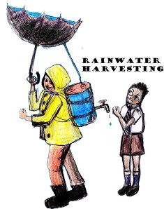

TO BENEFICIATE WATER QUALITY IN AQUIFERS.
TO CONSERVE SURFACE WATER RUNOFF DURING MONSOON
TO REDUCE SOIL EROSION.

Slide 8
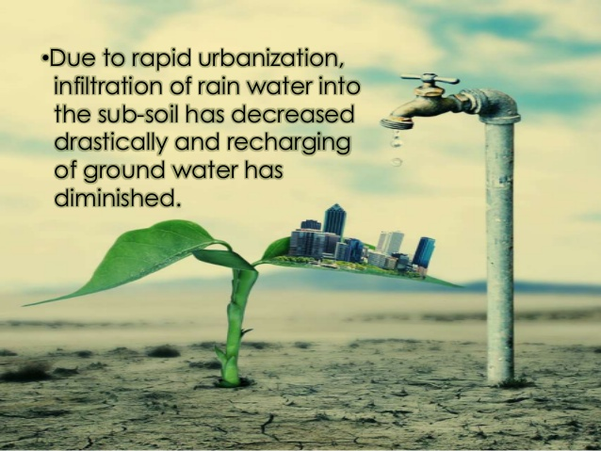

Slide 9

RAINWATER HARVESTING TECHNIQUES
ROOFTOP RAINWATER HARVESTING.
SURFACE RUNOFF HARVESTING.

Slide 10

ROOFTOP RAIN HARVESTING
Rooftop rainwater harvesting is the technique through which rainwater is captured from the roof catchments and stored in reservoirs. Harvested rainwater can be stored in sub-surface groundwater reservoir by adopting artificial recharge techniques to meet the household needs through storage in tanks.

Slide 11
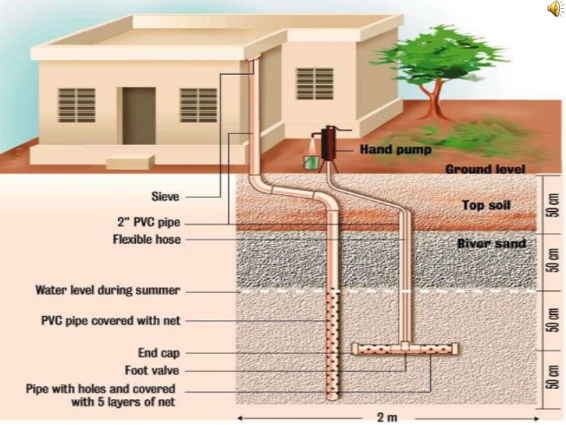

Slide 12
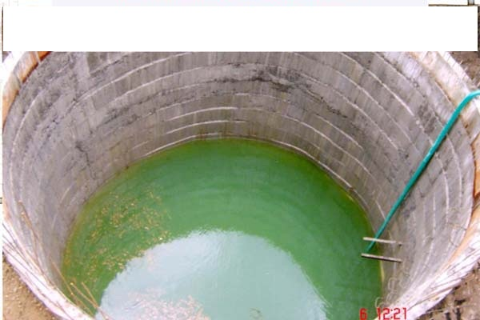
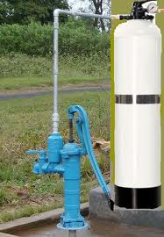
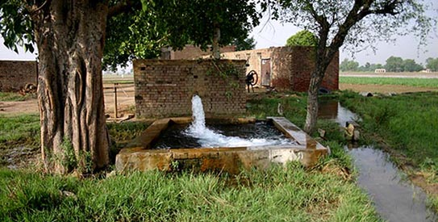
USES OF ROOFTOP RWH
Storage of direct use.
Recharging groundwater aquifer.
Recharging dug wells.
Recharging pits.
Recharging tube wells.

Slide 13
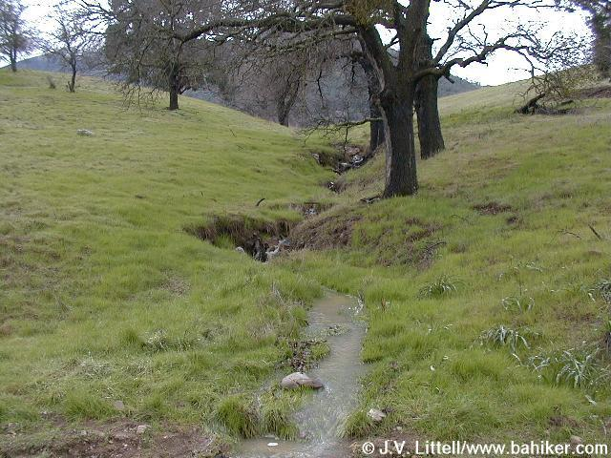
Surface runoff harvesting
In this method of collecting rainwater for irrigation, water flowing along the ground during the rains will be collected to a tank below the surface if the ground

Slide 14



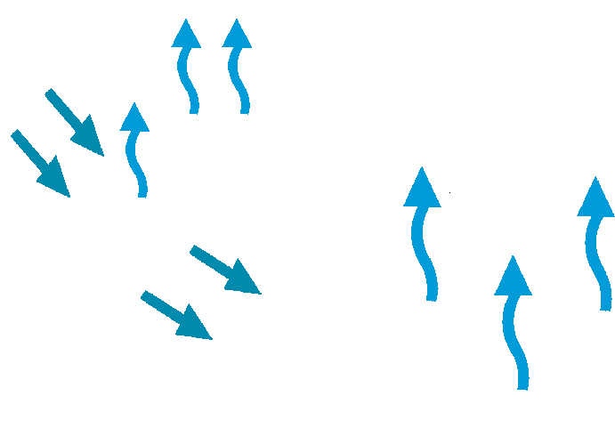




Condensation
Let’s take a look at
The Water Cycle
Precipitation
Evapotranspiration
Evaporation
Infiltration
Surface Runoff
Consumption
Surface Water
Groundwater
Sea water intrusion
Notes:
Narration: The hydrologic or water cycle is the continuous flow of water between reservoirs at or near the earth’s surface. As water falls to the ground as precipitation, it may develop as surface runoff into nearby surface waters or infiltrate into the ground and become stored as groundwater. Water stored in open areas, know as surface water, can evaporate into the atmosphere. In addition, water used by plants for normal growth or transpiration is also returned to the atmosphere. Once in the atmosphere water can condense into clouds and precipitate as rain or snowfall, initiating the cycle over again. Water is a renewable resource that, managed properly, can sustain the activities in the watershed for an indefinite period of time.
Animation: shows water cycle

Slide 15

Condensation
Rainfall Definitions
Intensity – Quantity per time of the rainfall event (mm/hour)
Precipitation
Duration – period of time for the precipitation event
Average Annual and Monthly Precipitation – Average rainfall over one year period and monthly intervals and usually based on 30 or more years of data
Consumption
Groundwater
Surface Water
Notes:
Narration: The hydrologic or water cycle is the continuous flow of water between reservoirs at or near the earth’s surface. As water falls to the ground as precipitation, it may develop as surface runoff into nearby surface waters or infiltrate into the ground and become stored as groundwater. Water stored in open areas, know as surface water, can evaporate into the atmosphere. In addition, water used by plants for normal growth or transpiration is also returned to the atmosphere. Once in the atmosphere water can condense into clouds and precipitate as rain or snowfall, initiating the cycle over again. Water is a renewable resource that, managed properly, can sustain the activities in the watershed for an indefinite period of time.
Animation: shows water cycle

Slide 16
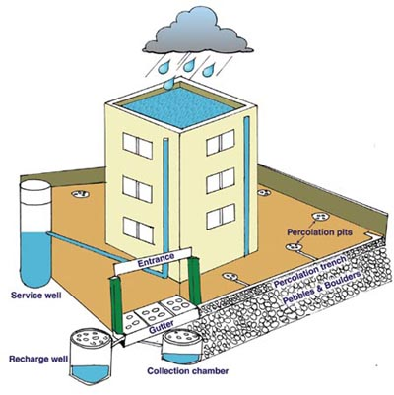
Rain Water Harvesting?.
Rain Water Harvesting RWH- process of collecting, conveying & storing water from rainfall in an area – for beneficial use.
Storage – in tanks, reservoirs, underground storage- groundwater
Hydrological Cycle

Slide 17

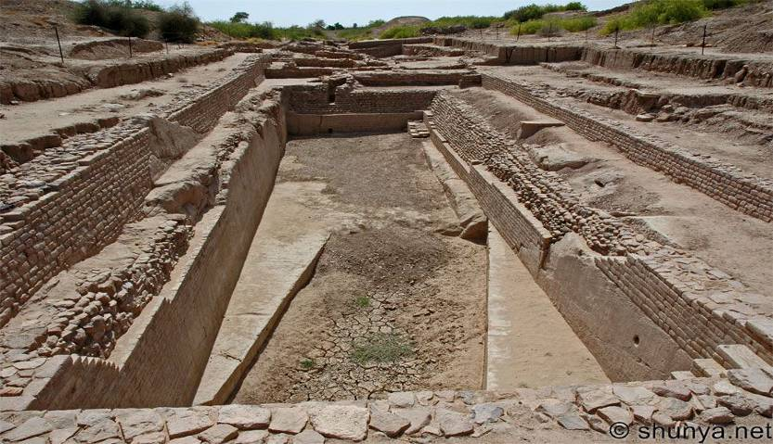
Not new to India
Rainwater storage reservoir at Dholavira (Rann of Kutch) – Harappan civilization (2500-1900 BC)
Notes:
The Harappan civilisation (2500-1900 BC) comprised a number of urban centres. Dholavira, in the great Rann of Kutch (in present-day Gujarat, western India), is one of them. The city was built in a semi-arid region averaging 260 mm rainfall annually. There were no perennial water sources. Subterranean water was saline, potable water scarce. How did Dholavira manage?
Two storm water channels, Manhar (north) and Mansar (south) flanked the city. The city was laid out on a 13 m gradient (higher in the east to lower in the west), ideal for reservoirs. It seems the planners knew this. They made a series of 16 reservoirs between the inner and outer walls of the city to collect the monsoon runoff from the channels, which amounted to 250,000 cu.m. of water.
Inside the citadel (inner city), there are large storm drains with apertures. These were not for wastewater, as archaeologists first thought, since they were not connected to housing or bathing platforms. These were for rainwater. The air-apertures ensured easy passage of rainwater.
Source: http://www.rainwaterharvesting.org/Solution/History_tour0.htm accessed November 2008
To the casual visitor, the most striking feature of Dholavira is its water management system. One gets the sense that every drop of water had to be saved. About 25 of the city's 250 acres are occupied by 16 rock cut reservoirs of various sizes. Linked by channels and dams, the reservoirs are quite spread out and must have added to the aesthetic appeal of this planned city.
Source: http://blog.shunya.net/shunyas_blog/2008/08/dholavira-a-har.html accessed November 2008
In one of the older water harvesting systems, about 130 km from Pune along Naneghat in the Western Ghats, a large number of tanks were cut in the rocks to provide drinking water to tradesmen who used to travel along this ancient trade route.

Slide 18
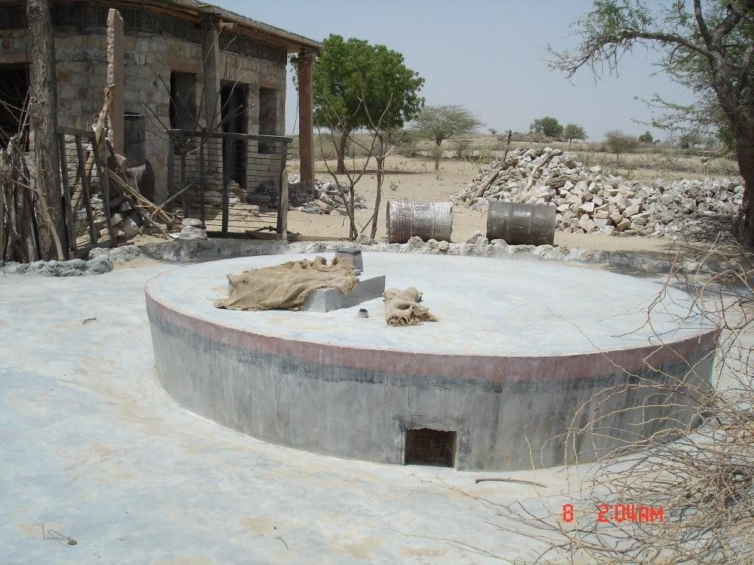
Tankas of Bikaner, Barmer, Phalodi - Rajasthan
Pipes from the rooftop lead rainwater into the tanka catchment
Note the slope provided for the rainwater (palar pani) to flow into the tanka
Notes:
Tankas are usually built using locally available materials. While some structures are built in stone masonry with stone slab coverings, others are built with only rudimentary plastering of bare soil surfaces of the tank with cement or lime and covering with Zizyphus Numularia thorns. Tankas that are accommodated inside a house/courtyard are typically made of chiseled blocks of stone, in lime mortar and are made waterproof by an indigenous herbal mix, which seals minor cracks and prevents bacteriological growth inside the tanka.
The size of the tanka is large enough to store sufficient drinking water for a family for six to eight months. An average storing capacity of the tanka is around 25,000 litres and a tanka can be as large as 20 feet x 60 feet x 12 feet.
The tanka feeds on the rainwater collected through roof runoff. Inlet holes are provided in the convex covering at the ground level to facilitate entry of rain water into the tank. The wall of the tanka is kept projecting above the ground to provide inlet holes. When the owner is certain of the cleanliness of rainwater (done by constant visual testing and actual tasting of water) the tanka inlet is opened. Tankas have a hatch cover, which is kept closed except for the time when water is needed. Some tankas have a fish marked on the inside. Water is usually not filled above this level as the hydraulic pressure inside may exceed the retaining capacity of the tanka wall.
The tanka water is stored to be used long after the rains have stopped. The clean conditions of collection and storage makes the tanka water a most precious resource in the hot summer months. When required to be cleaned, tankas must be emptied manually, they are large enough for people to enter and work inside. The tanka floor slopes into a sump right under the point from where the water is drawn out.
http://www.unescoparzor.com/tankakyoto.html

Slide 19
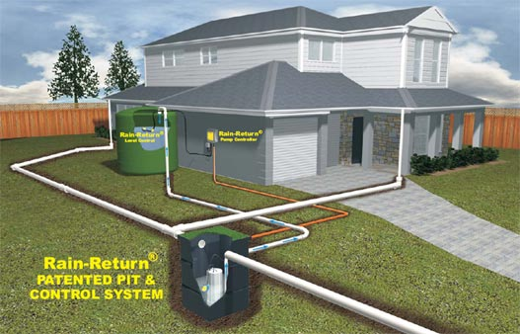

Slide 20
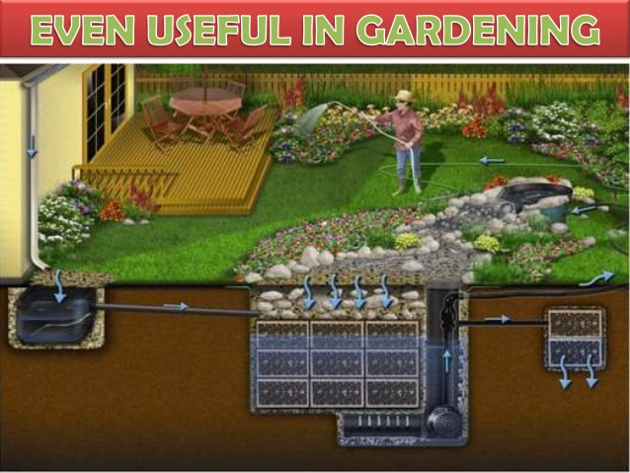

Slide 21
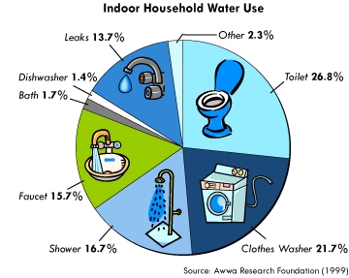
USES OF RAINWATER HARVESTING.

Slide 22
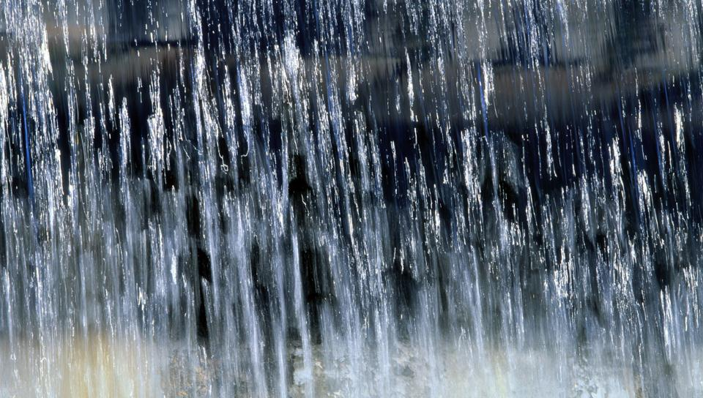
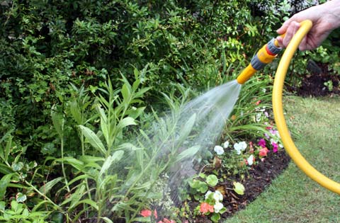
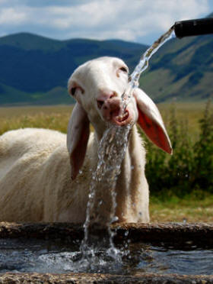
WATER FOR GARDEN
WATER FOR LIVESTOCK

Slide 23
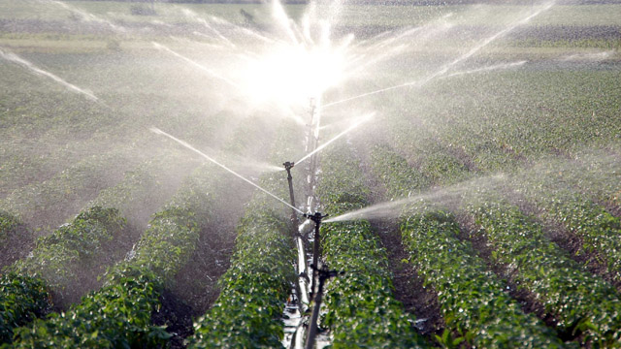

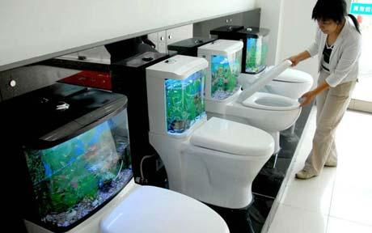
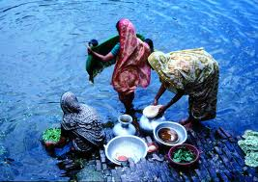
WATER FOR IRRIGATION
DRINKING WATER AS WELL AS FOR STORAGE AND PURPOSES LIKE TOILET,LAUNDRY AND GARDEN USE.

Slide 24
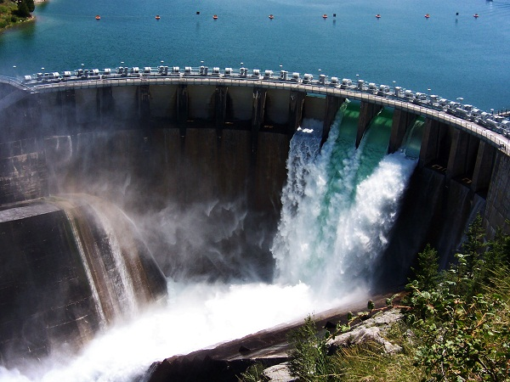
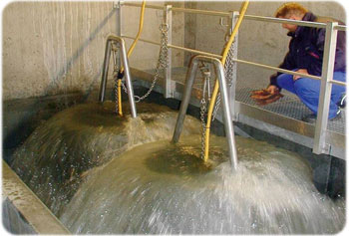
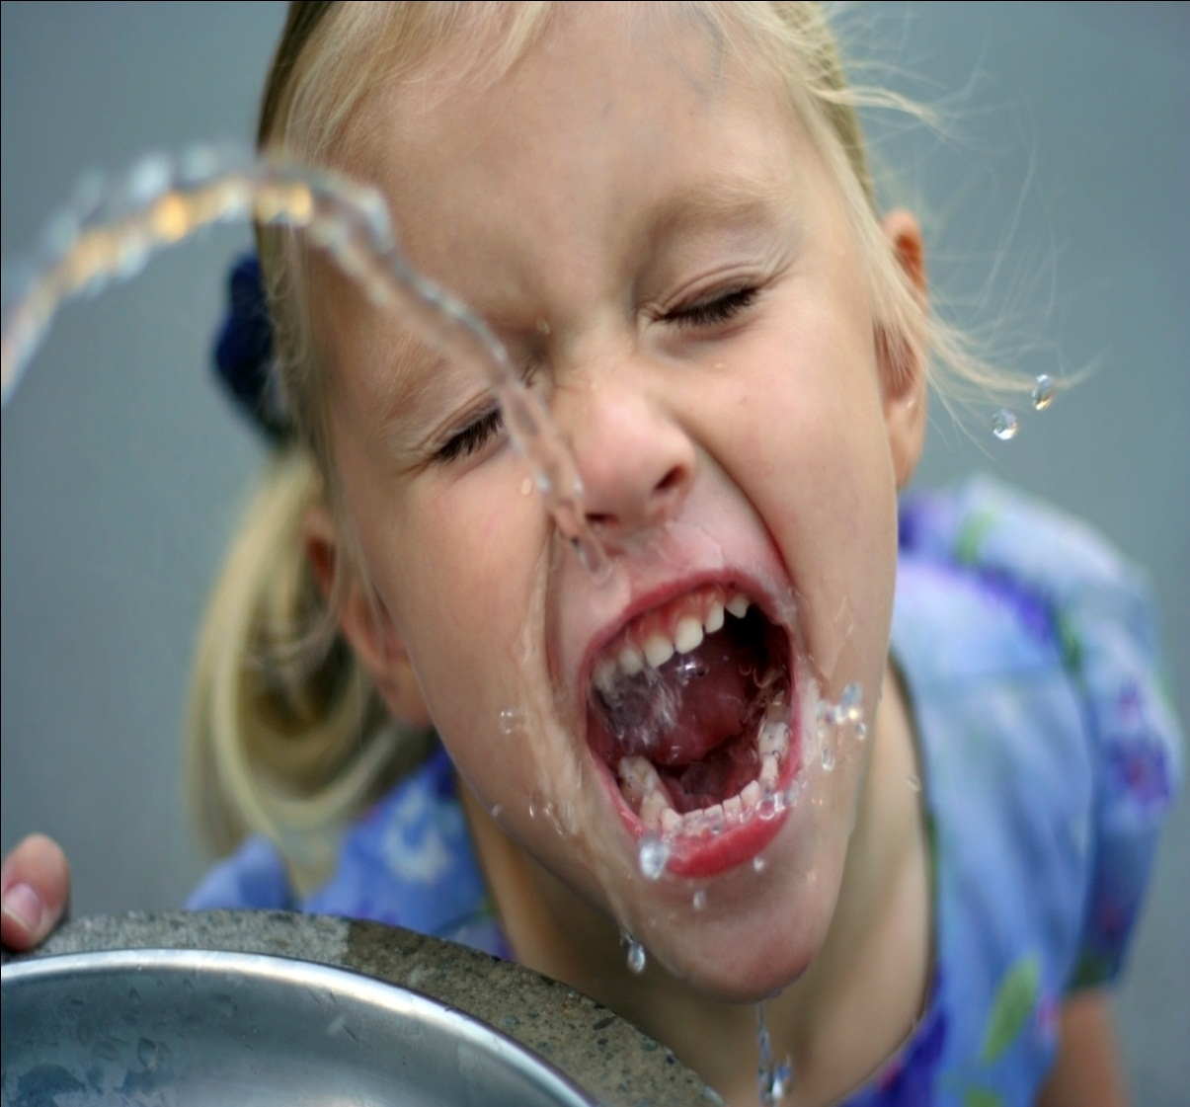
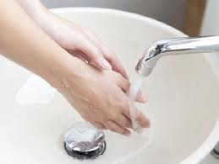
AS A RAW MATERIAL FOR SEVERAL INDUSTRIES.
FOR DRINKING,CLEANING PURPOSES AND GENERATING HYDROELECTRICITY.

Slide 25
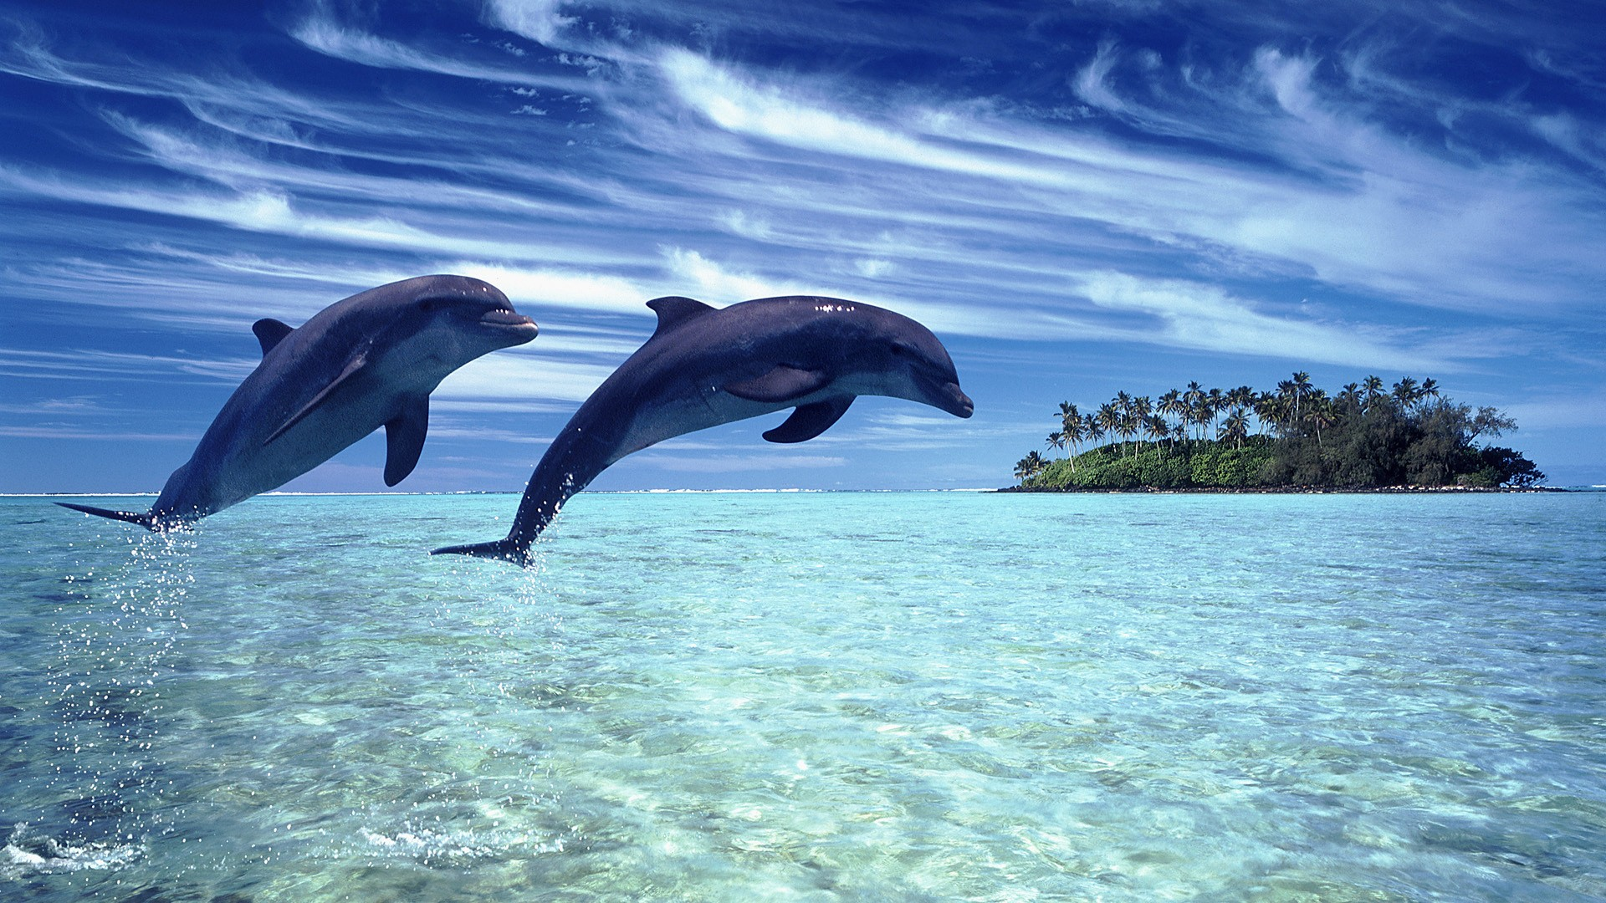
ADVANTAGES OF RWH
It can save up to 50% of water for reuse.
Reduces water bills when domestic charges are introduced.
Improves sustainability of water use
Adds value to property.
It is a low maintenance system.
Extracting water is extremely simple: open tap – water flows!!!!

Slide 26
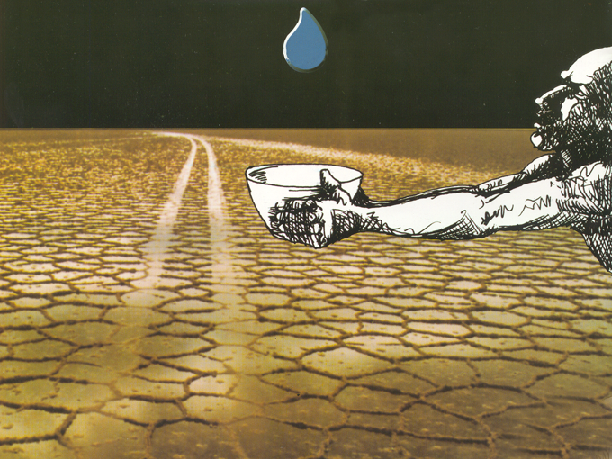
Thank you for your Seeing

